Slide 1
WEB Scraping
Done by Kaveh Karimadini

Slide 2
TABLE OF CONTENTS
Web scraping
02
01
Web crawling
crawling VS scraping
03
04
Hands On

Slide 3
Web Crawling
The ART of Data Collection

Slide 4
What is web crawling?
Web Crawling
Google use crawlers to discover and index web pages.
Crawling process:
following links, discovering new pages, and storing information.
Benefits:
Helps users find relevant information on the web

Slide 5

What is web scraping?
Web Scraping
web scraping extracts specific data points from web pages.
Techniques:
Selenium with python
Applications:
Data Collection

Slide 6
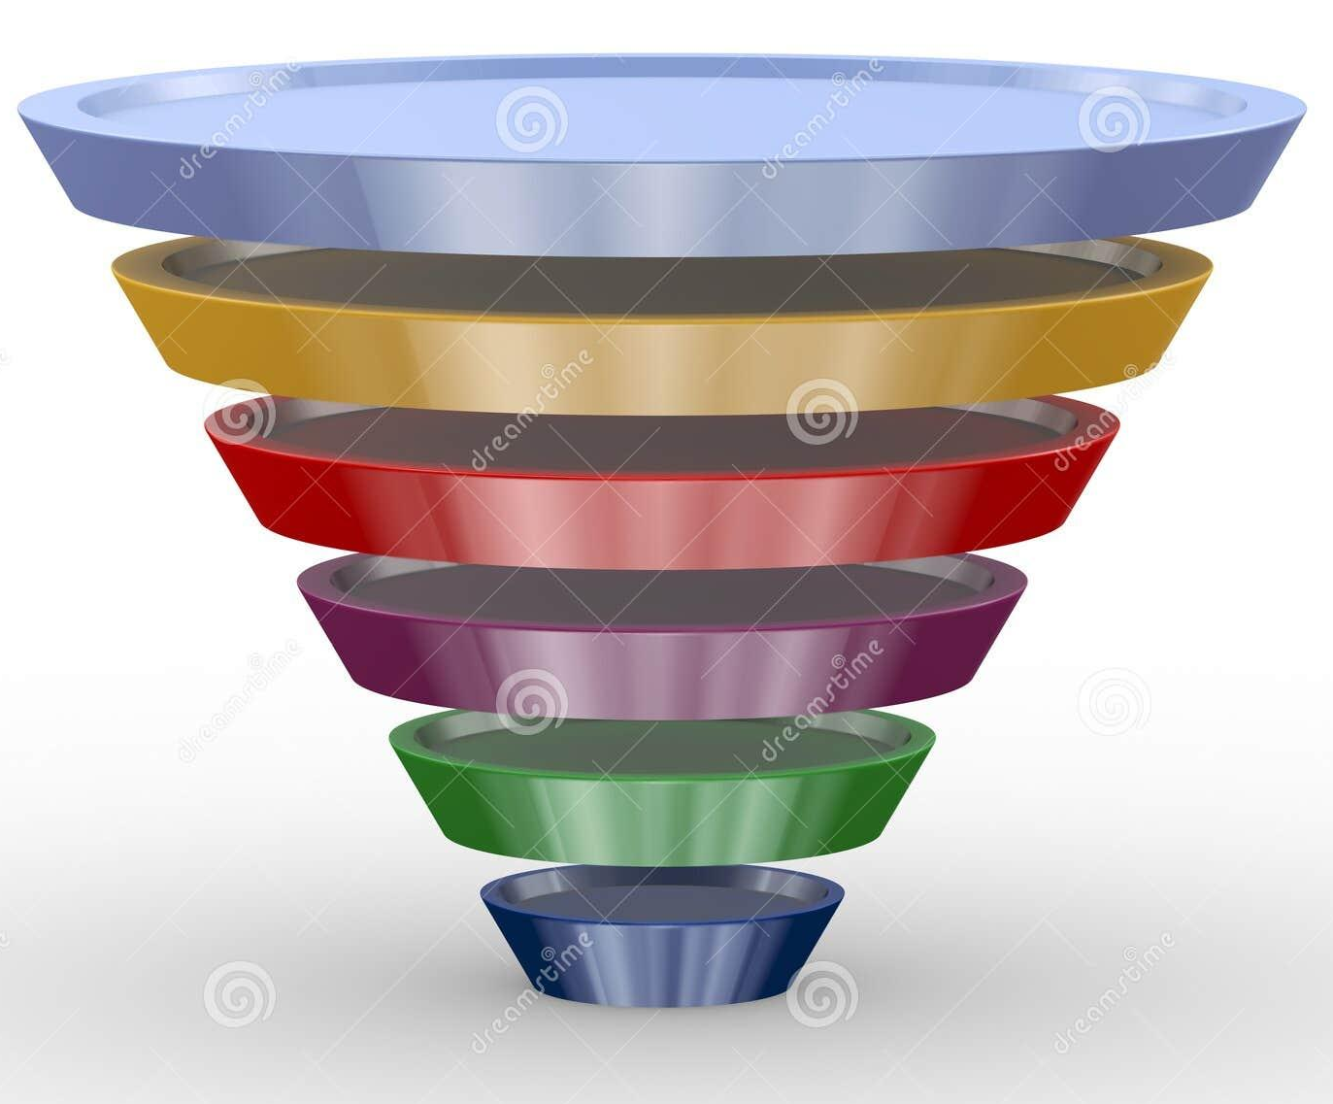
Web Crawling VS Scraping
General to Specific

Slide 7
Key Differences
1
Crawling: Discovers and indexes web pages. It's like exploring the entire library to find all the books.
Scraping: Typically targets specific websites or sections of a website, like a product category page.
2
Crawling: Often stores basic information about web pages, like titles and URLs, for indexing purposes.
Scraping: Needs to parse and clean the extracted data to make it usable (e.g., removing HTML tags, converting formats).

Slide 8
— Kaveh Karimadini
“Practice makes perfect”
Hands On Project: LinkedIn_scraper.ipynb

Slide 9
THANKS!
Does anyone have any question?
kavehkarimoodini@gmail.com
+98 09058605654

